Slide 1

Car rental website project
Your Journey Begins Here!
BY : Satyam and Yash
Degree Program: Bachelor of computer Application
University: Rajasthan University

Slide 2
Introduction
This project is a culmination of our efforts during our final year of BCA.
The objective of our project is to develop a user-friendly and efficient car rental website that simplifies the process of renting vehicles.
Our website aims to provide a seamless and hassle-free experience for customers, ensuring their journey begins smoothly from the moment they book their desired vehicle.

Slide 3

Project Overview
Our car rental website is a comprehensive platform designed to simplify the process of renting vehicles for customers.
With a user-friendly interface and advanced search functionalities, the website enables users to find and book their desired cars quickly and conveniently.
Key Features:
Extensive vehicle inventory with various makes, models, and types available for rent.
Secure and seamless online booking system for easy reservation management.
User registration and personalized profiles for a tailored rental experience.
Target Audience:
Individuals and families seeking reliable and affordable car rental services for their travel needs.
Business travelers looking for convenient transportation options during their trips.

Slide 4
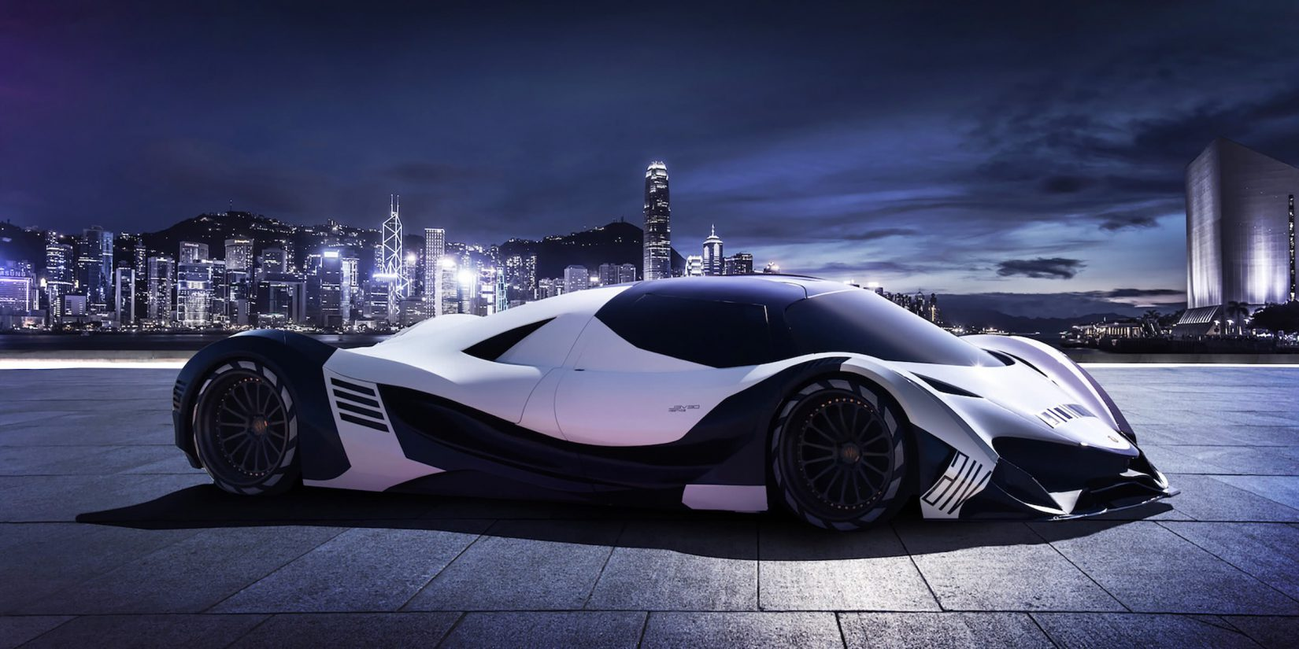
User Interface Design
Our car rental website features a modern and intuitive user interface, providing a seamless user experience for visitors.
We utilized a combination of HTML, CSS, JavaScript, and Bootstrap to create a visually appealing and responsive design.
The website incorporates a clean and organized layout, ensuring easy navigation and accessibility for users.

Slide 5
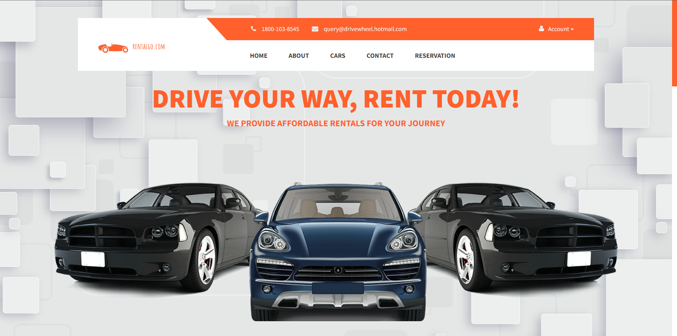
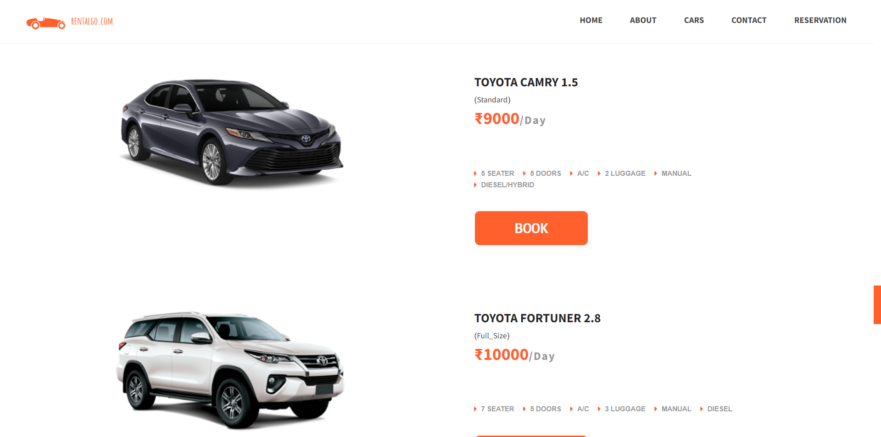
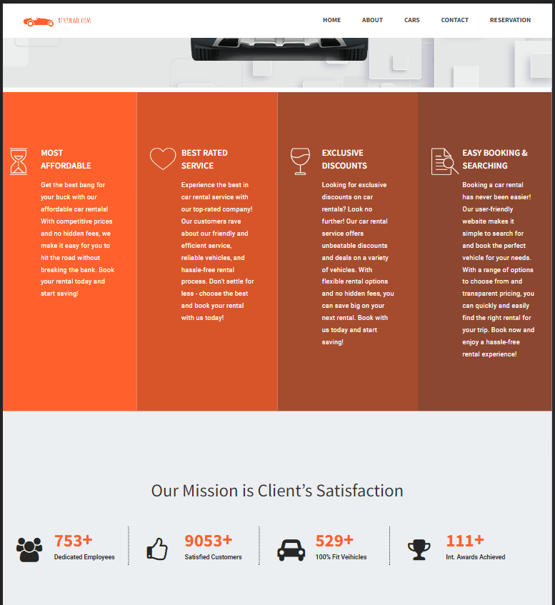
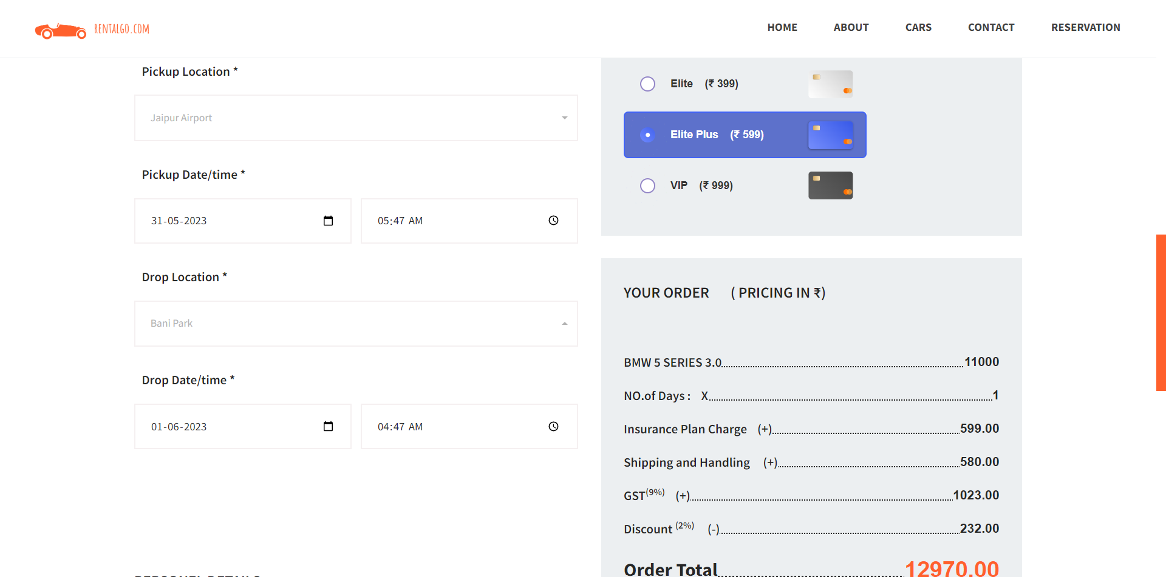
Website user Interface screenshots

Slide 6
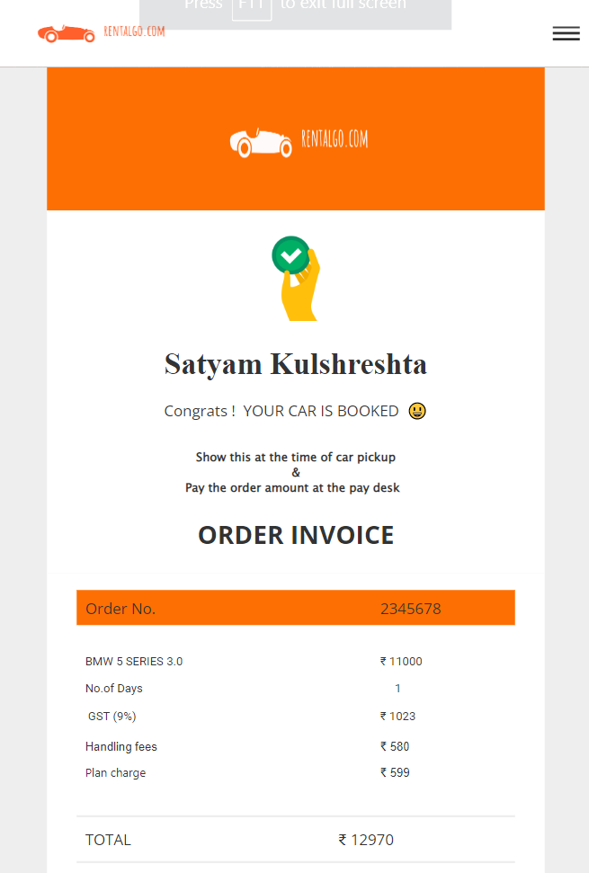
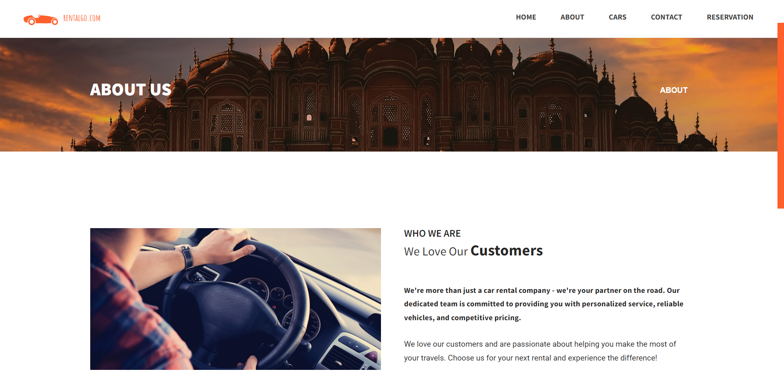
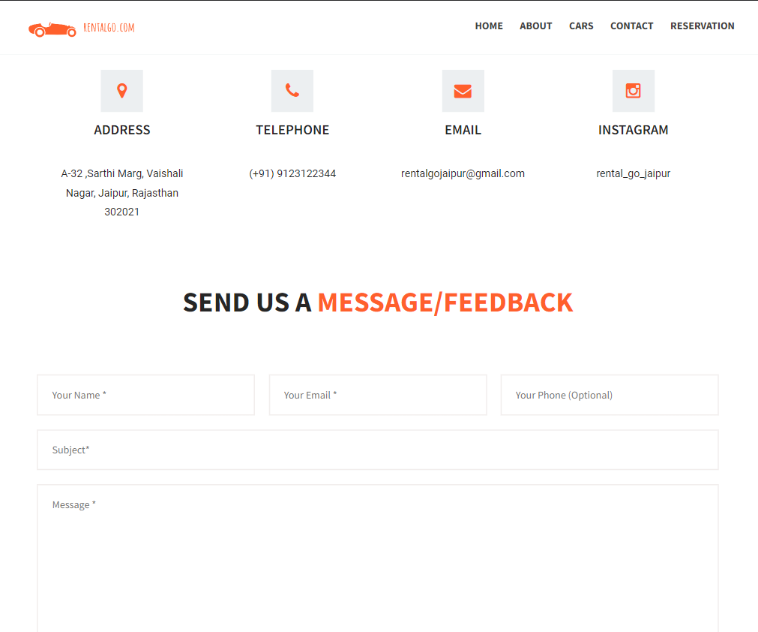
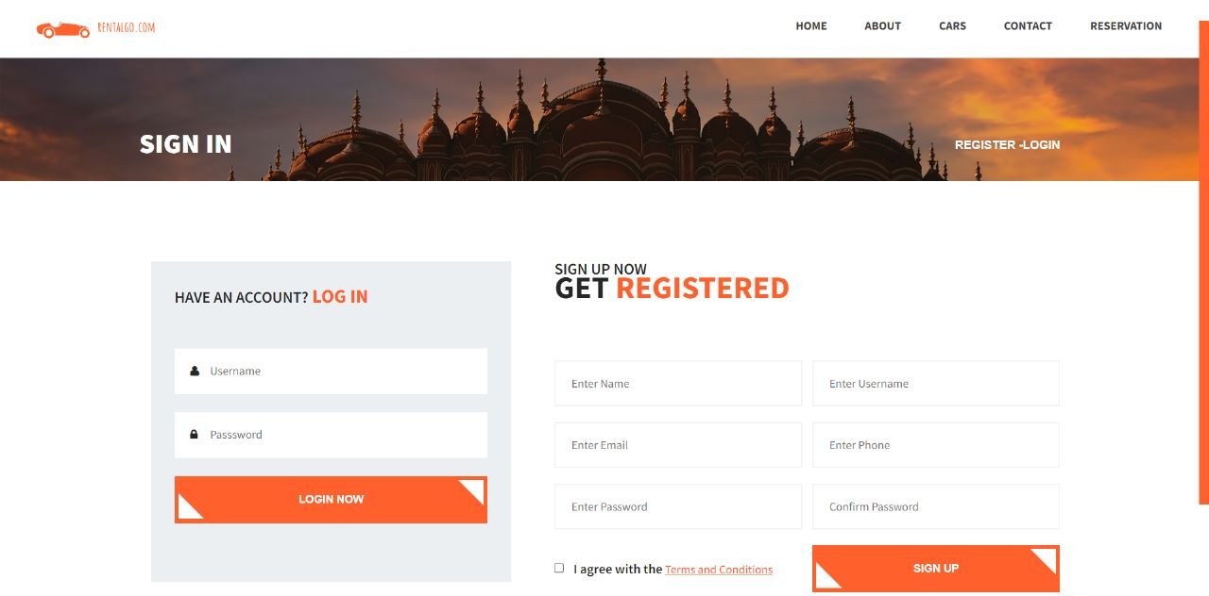
Website user Interface screenshots

Slide 7
Technology Stack
HTML: Used for structuring the content and elements of the website.
CSS: Used for styling and enhancing the visual presentation of the website.
JavaScript: Used for implementing dynamic and interactive features on the website.
jQuery: Used as a JavaScript library for simplifying DOM manipulation and event handling.
Bootstrap: Used as a CSS framework for responsive and mobile-first web development.
Java EE (Java Enterprise Edition): Used for the backend development and business logic implementation.
JDBC (Java Database Connectivity): Used for connecting the Java application with the MySQL database.
API (Application Programming Interface): Utilized to integrate external services and enhance functionality.

Slide 8
Technology Stack
Benefits of Technology Stack:
HTML, CSS, and JavaScript provide a solid foundation for creating engaging and interactive web pages.
jQuery simplifies the JavaScript code and enables faster development.
Bootstrap ensures a responsive and visually appealing design across different devices and screen sizes.
Java EE offers a robust framework for scalable and secure enterprise-level applications.
JDBC facilitates seamless interaction with the MySQL database.
Utilizing APIs allows for integration with third-party services, enhancing the overall functionality of the website.

Slide 9
Database and Backend
Our car rental website utilizes a MySQL database for efficient data storage and retrieval.
The database stores information such as customer details, vehicle inventory, booking records, and more.
We have implemented a relational database schema to ensure data integrity and efficient query operations.
Java and Java EE are the primary technologies used for developing the backend functionalities.
Java provides a robust and object-oriented programming language, while Java EE offers a comprehensive set of tools and libraries for enterprise-level applications.
We have used Java Server Pages (JSP) and Java Servlets to handle dynamic content generation and request processing.
Additionally, Java Database Connectivity (JDBC) is employed to establish a connection between the Java application and the MySQL database.
The backend architecture ensures seamless data flow, secure transactions, and reliable performance.

Slide 10
Key features and Benefits
KEY FEATURES :
Easy vehicle search and selection: Users can quickly search for their desired vehicles based on location, dates, and preferences.
Secure online booking: A secure and user-friendly booking system allows customers to make reservations conveniently.
User registration and profiles: Users can create personalized profiles to manage their bookings and preferences efficiently.
Responsive design: The website is designed to be responsive, ensuring a seamless experience across devices and screen sizes.
Customer support: Dedicated customer support is available to assist users with their queries and concerns.

Slide 11
Key features and Benefits
BENEFITS :
Time-saving: Users can save time by easily finding and booking their desired vehicles without the need for extensive research.
Convenience: The online booking system offers 24/7 accessibility, allowing users to make reservations at their convenience.
Enhanced security: The secure payment gateway ensures the safety of users' financial transactions.
Personalization: User profiles enable a personalized experience, storing preferences and making future bookings more efficient.
Reliable support: Dedicated customer support ensures prompt assistance and resolves any issues or inquiries.

Slide 12
CONCLUSION
In conclusion, our car rental website project has been a successful endeavor, resulting in the creation of a functional and user-friendly platform for car rentals.
We have achieved our objectives of developing an intuitive user interface, incorporating essential features, and ensuring a seamless booking experience for users.
The utilization of HTML, CSS, JavaScript, jQuery, Bootstrap, Java EE, and other technologies has enabled us to create a visually appealing and responsive website with robust backend functionalities.
We would like to express our sincere gratitude to our team members for their dedication, collaboration, and hard work in bringing this project to fruition.
Special thanks go to our mentors and faculty members who provided guidance, feedback, and support throughout the project's duration.
We are proud of our accomplishment and confident that our car rental website will serve as a valuable resource for users in need of convenient and reliable car rental services.

Slide 13

THANK YOU!
Thank you for being a part of our presentation on our Car Rental Website Project.
We extend our heartfelt gratitude to our mentors, faculty members, team members, and audience for their valuable support and contributions.
Your involvement has been crucial to our project's success. If you have any further inquiries or would like to know more, please feel free to contact us.
Thank you once again for your support.

